Slide 1

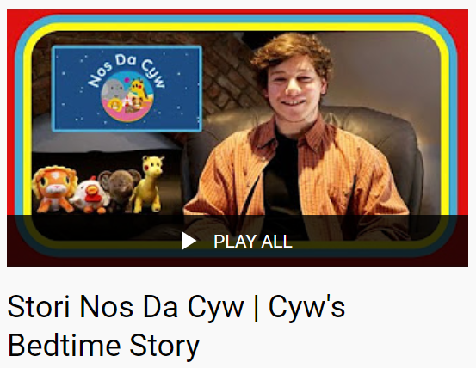
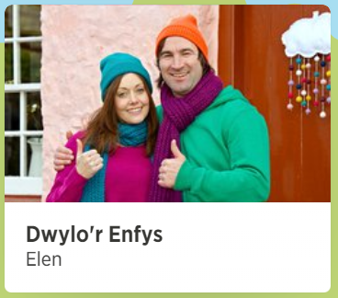


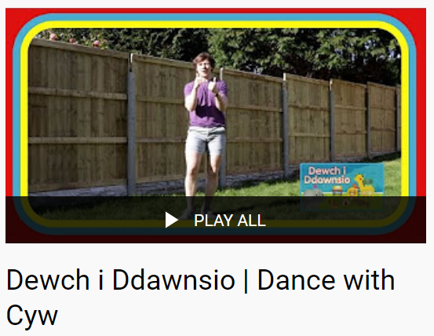
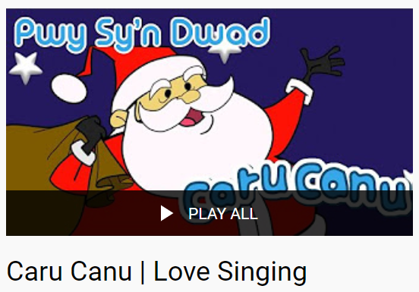
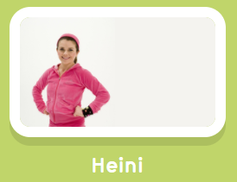
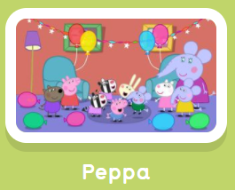






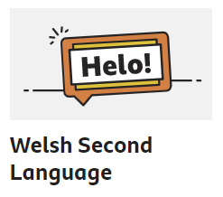


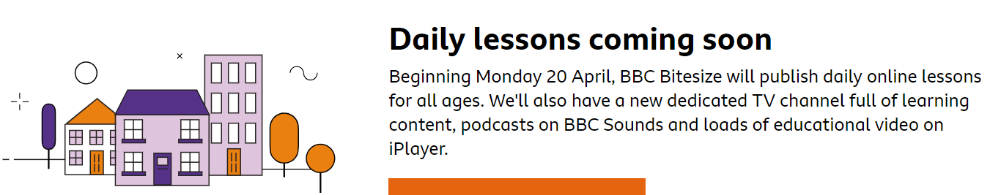
Gwefannau - Websites
Cyw Tiwb
watch children’s TV
https://www.s4c.cymru/clic/Categories/13
learn sign language
keep fit
favourite shows in Welsh
learn Welsh
www.bbc.co.uk/wales/learning/learnwelsh
https://www.bbc.co.uk/bitesize/primary
Videos teaching Welsh letter sounds to learners. Watch them in this order:
Yellow > Blue > Green > Pink > Grey
https://www.youtube.com/channel/UCBQzkEuTgYOCz5Dzo2OPD0A/videos
Listen to stories
and rhymes
www.poridrwystori.org.uk/audio-stories
www.poridrwystori.org.uk/audio-rhymes

Slide 2

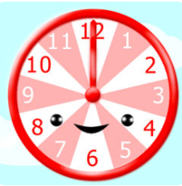
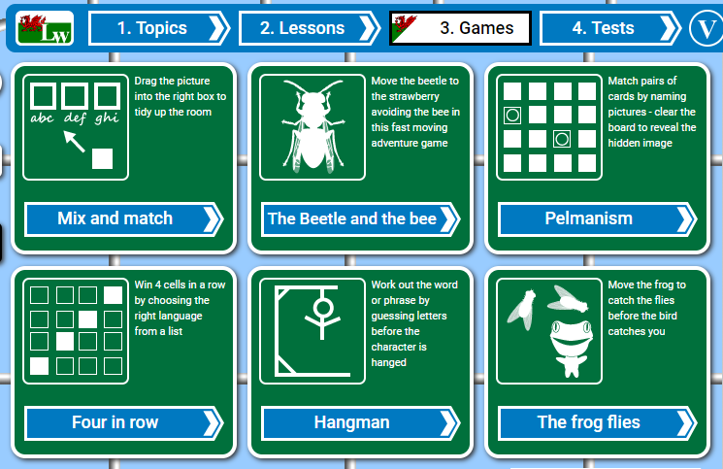
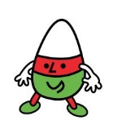






Gwefannau - Websites
www.canolfanpeniarth.org
Click on:
web and interactive
Clock Game
www.learnwelsh.net
Urdd Gobaith Cymru
www.urdd.cymru
Activity sheets available:
https://www.urdd.cymru/cy/ieuenctid/criw/criw-cynradd/gweithlenni-i-ddysgwyr/
www.bbc.co.uk/wales/learning/learnwelsh
https://www.bbc.co.uk/bitesize/primary
http://cymraeg.gov.wales

