Slide 1



Slide 2

1.3 Standards and Progress in skills
Inspectors should consider pupils’ standards in Welsh compared with schools in similar contexts and pupils’ previous attainment. They should consider pupils’ progression from the Foundation Phase to Key Stage 2. Inspectors should consider the progress pupils make in developing their Welsh language skills across the curriculum and across the school. They should consider how well pupils know about the advantages of learning Welsh and becoming bilingual.
Comments from the
New ESTYN Framework
3.3 Provision for Skills
Inspectors should evaluate the extent and quality of the school’s provision for the development of Welsh language skills in formal teaching activities and in informal situations. They should consider how well the school teaches pupils about the advantages of learning Welsh and becoming bilingual. It is a statutory requirement that all pupils learn Welsh up to the age of 16.

Slide 3
4.2 Personal Development (including spiritual, moral, social and cultural development.)
Inspectors should consider how well the school encourages pupils to use their imagination and to engage with the creative arts through their studies, extra-curricular activities and educational visits. They should consider the extent to which school give pupils’ the opportunity to participate in performance, as individuals and in groups, to foster their self confidence, their expressive capacities and their ability to work in a team.
Inspectors should consider how well the school provides lunchtime and after school opportunities or puts on assemblies, performances or Eisteddfodau to encourage pupils to participate in the arts and in sports and recreations.
5.1 Quality and effectiveness of leaders and managers
Inspectors should evaluate the extent to which leaders and managers plan strategically to provide purposeful opportunities for pupils to develop their Welsh language skills in formal and informal situations.

Slide 4
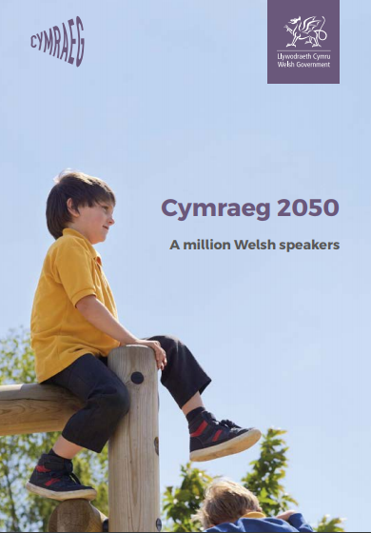
The Welsh language is one of the treasures of Wales. It is part of
what defines us as people and as a nation. Our ambition as Welsh
Government is to see the number of people able to enjoy speaking
and using Welsh reach a million by 2050. This is certainly a challenging
ambition, but a challenge we believe is worthwhile and necessary if we
are to secure the vitality of the language for future generations.

Slide 5
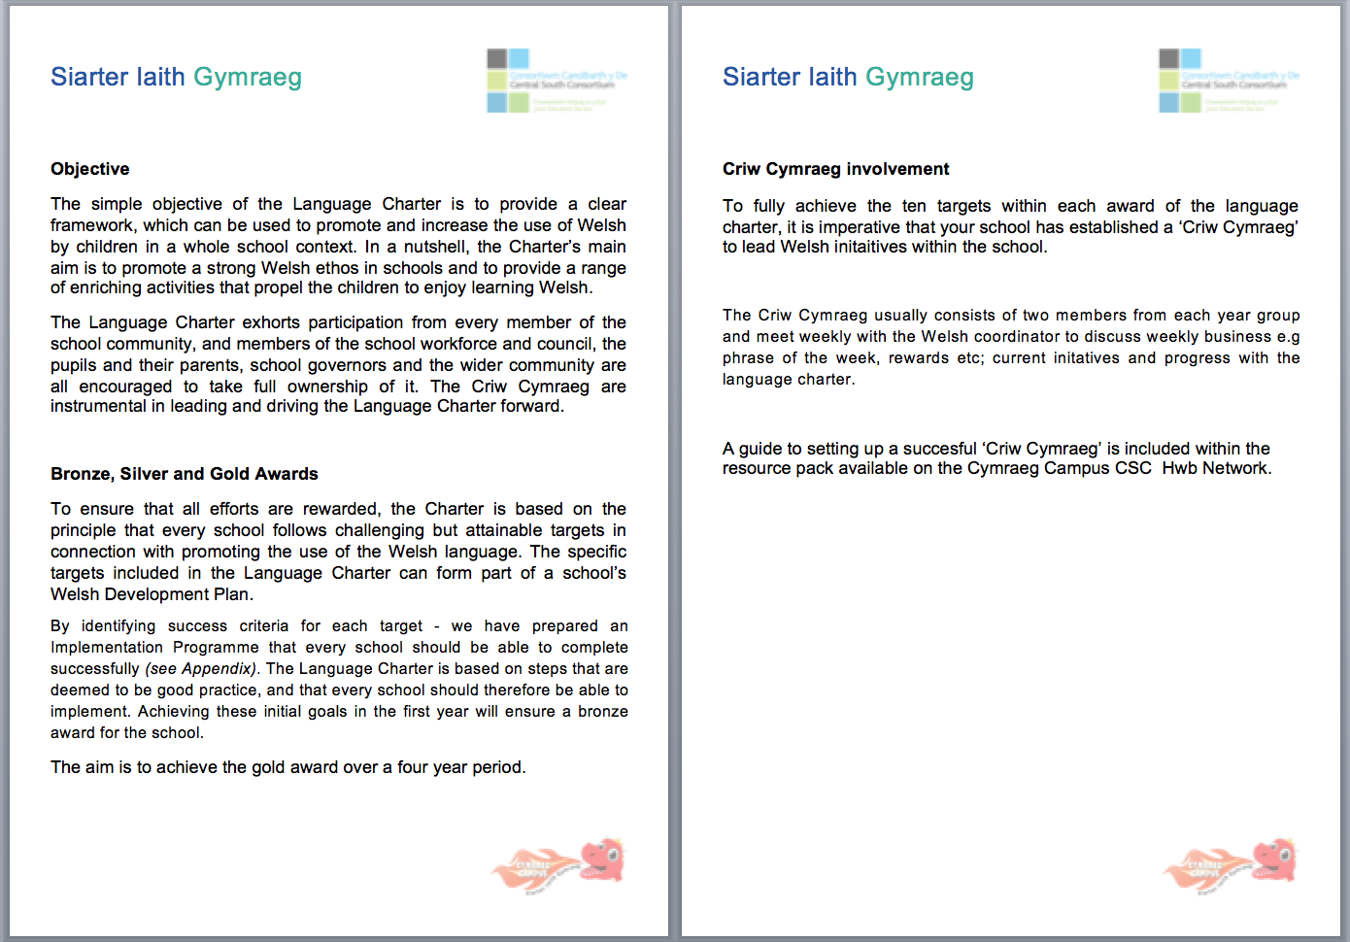

Slide 6
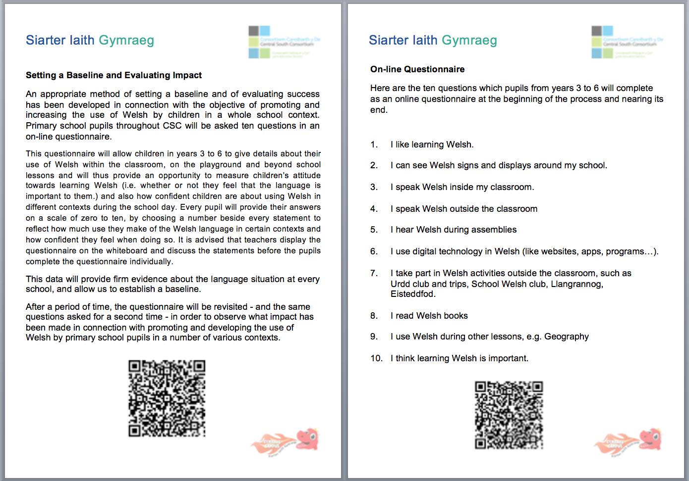

Slide 7
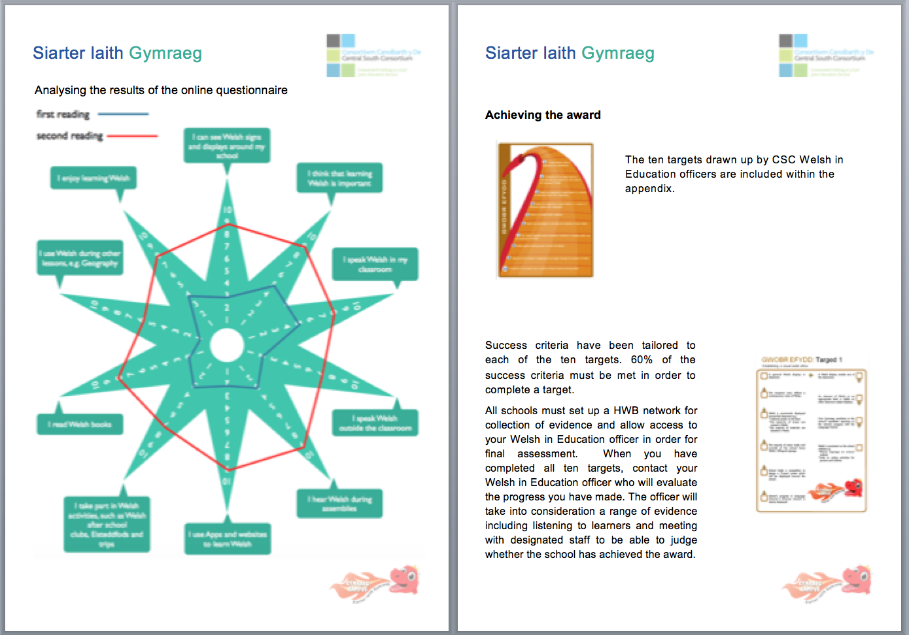

Slide 8
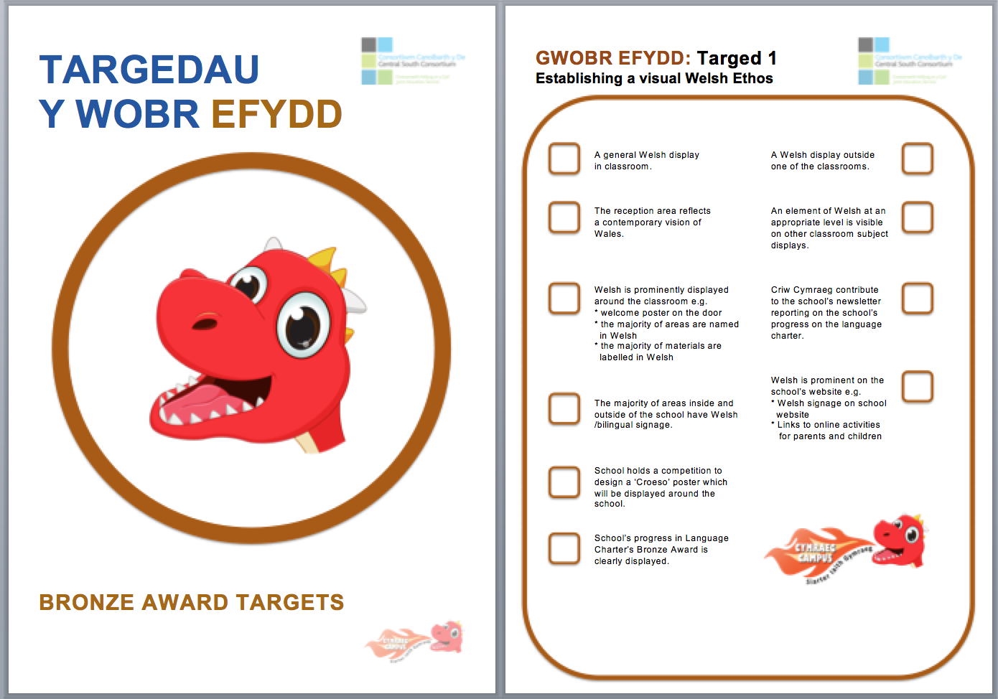

Slide 9
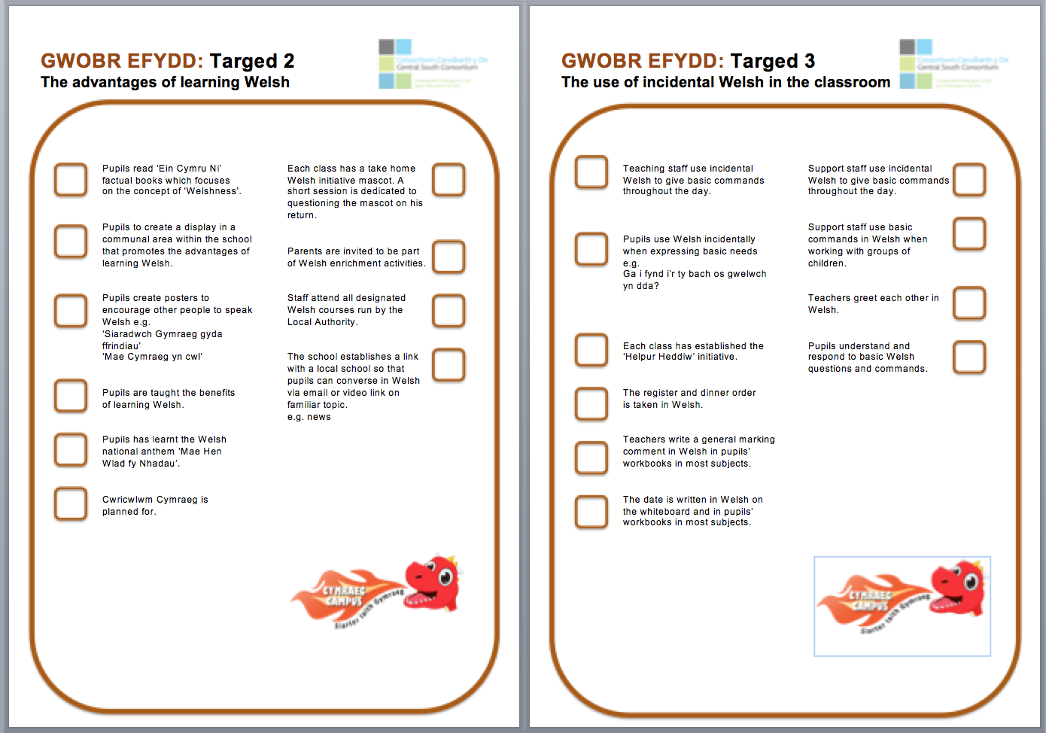

Slide 10
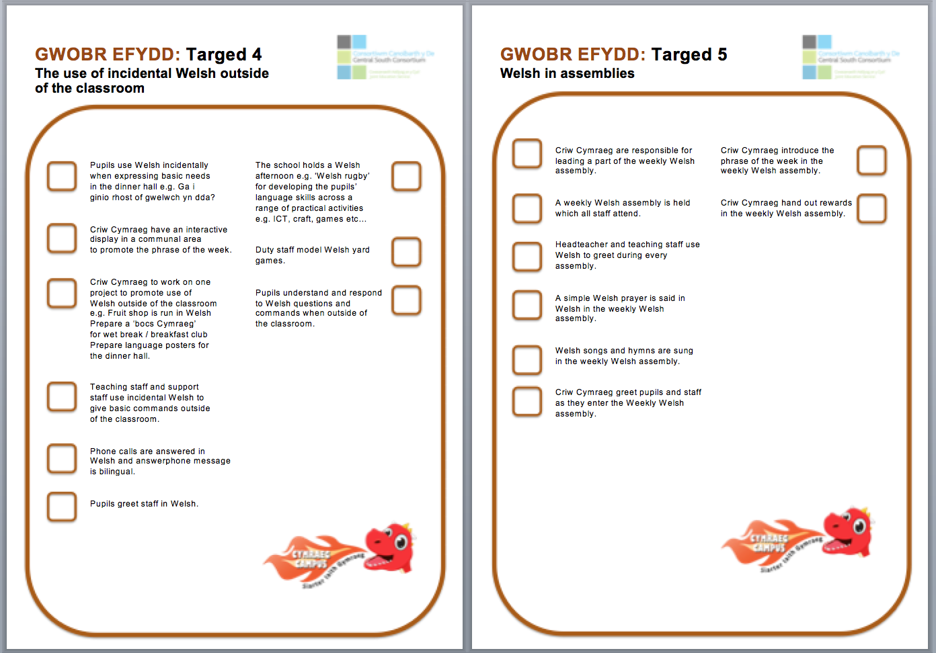

Slide 11
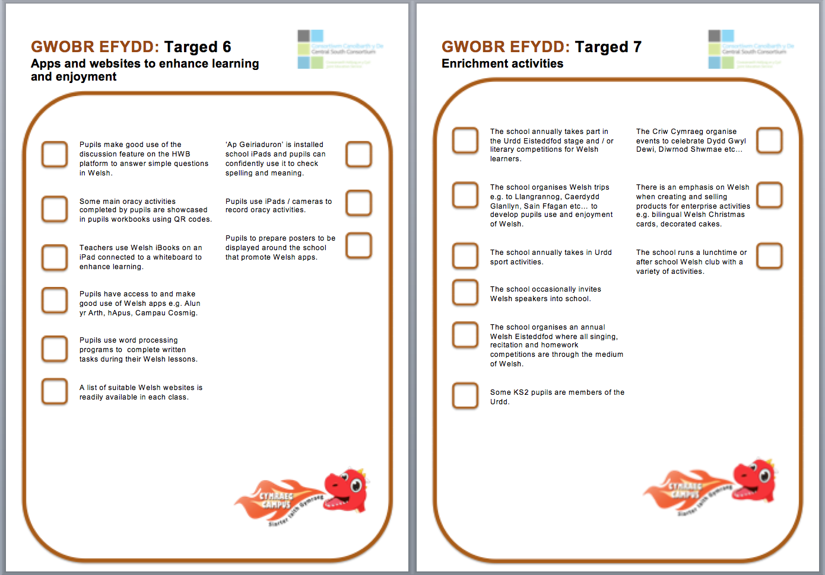

Slide 12
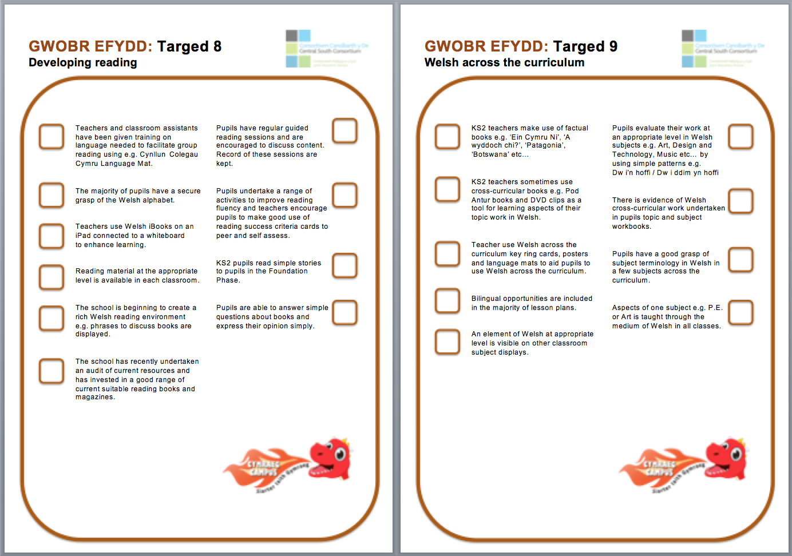

Slide 13
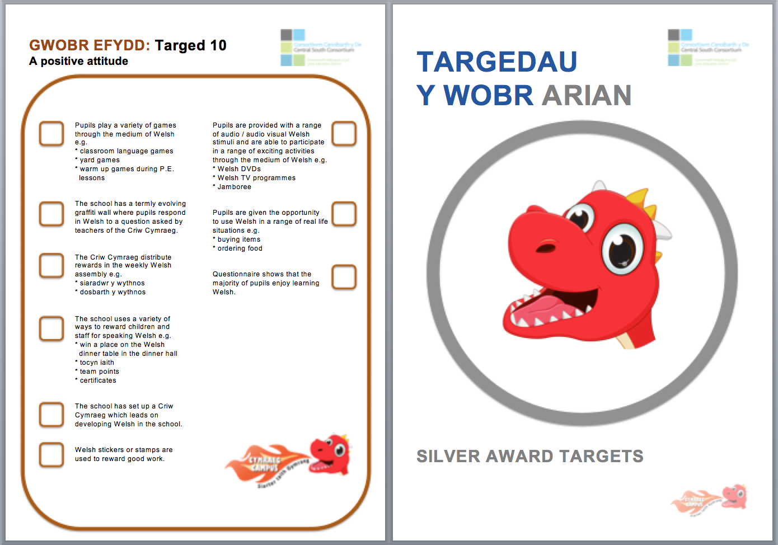

Slide 14
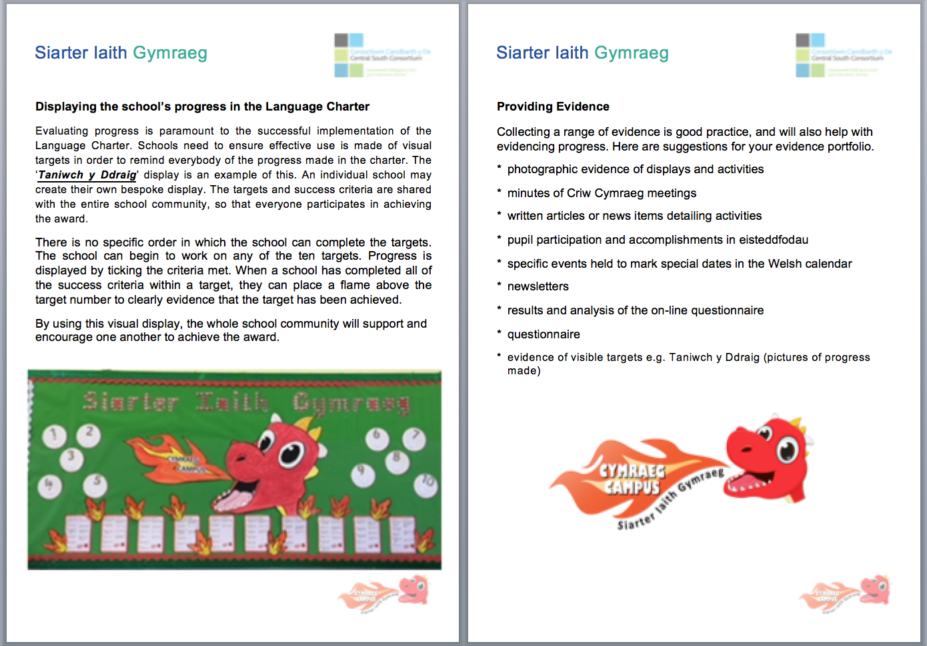

Slide 15


