Slide 1

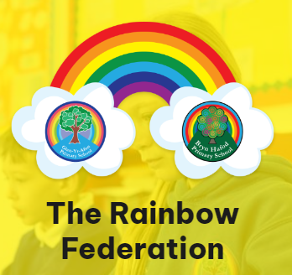
Welsh for
Parents

Slide 2

https://www.youtube.com/watch?v=h-zu72YpXKY
Yr Wyddor Gymraeg
The Welsh Alphabet
A ah
B buh
C cuh
Ch (from the back of throat) as in loch, Bach (kh)
D duh
Dd (th, as in the)
E air
F v
Ff f
G guh
Ng as in sing
H huh
I ee
J juh
L l
Ll (blow through back teeth)
M m
N n
O or
P puh
Ph f
R r (rolling)
Rh rh (rolling)
S s (as in soft)
T tuh
Th th (as in think)
U ee
W oo (as in noon)
Y ur or u (as in up)

Slide 3

Welsh number | Pronunciation
1=un 2=dau 3=tri 4=pedwar 5=pump 6=chwech 7=saith 8=wyth 9=naw 10=deg 11=un deg un 12=un deg dau 13=un deg tri 14=un deg pedwar 15=un deg pump 16=un deg chwech 17=un deg saith 18=un deg wyth 19=un deg naw 20=dau ddeg | Een Dai Tree Pedwarr Pimp Kwairckh S eye th Oyth Now Dairg Een dairg een Een dairg dai Een dairg tree Een dairg pedwarr Een dairg pimp Een dairg Kwairckh Een dairg s-eye-th Een dairg oyth Een dairg now Dai there-g
https://www.youtube.com/watch?v=lxMYf9y5qg4

Slide 4
https://www.youtube.com/watch?v=rySWpRmZS7A
glas | gwyrdd | melyn | coch
du | gwyn | porffor | oren
pinc | llwyd | brown
Lliwiau

Slide 5

https://www.youtube.com/watch?v=QD6XUDLzo8k
Dyddiau’r Wythnos/ Days of the Week
Dydd Llun (deeth ll-een) Monday
Dydd Mawrth (deeth mowrth) Tuesday
Dydd Mercher (deeth merr-kherr) Wednesday
Dydd Iau (deeth y-igh) Thursday
Dydd Gwener (deeth gwen- err) Friday
Dydd Sadwrn (deeth sad-oo-rn) Saturday
Dydd Sul (deeth seal) Sunday

Slide 6

Misoedd y Flwyddyn/Months of the Year
Ionawr (yon-owrr) January
Chwefror (khwe-vrrohrr) February
Mawrth (mow-rth) March
Ebrill (air-br-ill) April
Mai (m –ie…’ie’ as in pie) May
Mehefin (meh-hev-in) June
Gorffennaf (guh-orr-fen-arv) July
Awst (owst) August
Medi (meh-dee) September
Hydref (huh-drev) October
Tachwedd (tahkh-weth) November
Rhagfyr (Rag-virr) December

Slide 7

Cyfarchion/ Greetings
Welsh | Pronunciation | English
Helo/ Shwmae Bore da Prynhawn da Noswaith dda Nos da Hwyl Fawr | (shoe – my) (bo-rre dah) (pruhn-hown dah) (noss-why-th thah) (noss-da) (Hoil vowrr) | Hello Good morning Good afternoon Good evening Goodnight Goodbye

Slide 8
Welsh | Pronunciation | English
Os gwelwch yn dda/ plîs Diolch (yn fawr iawn) Croeso Esgusodwch fi Mae’n ddrwg ‘da fi | (os gwel-ookh-een thah) (dee-olch (uhn vowrr yown) (kroy-ssohh) (ess-gi-sod-ookh-vee) (Mine thrroog ‘da vee!) | Please Thank you (very much) You’re welcome Excuse me I’m sorry

Slide 9
Welsh | Pronunciation | English
Pwy wyt ti? ____ ydw i. Beth ydy dy enw di? Fy enw i ydy___. Sut wyt ti? Dw i’n hapus. wedi blino Ble rwyt ti’n byw? Dw i’n byw ________. | (Pooee ooeet tee?) (____udoo ee) (Bairth udee duh enoo dee?) (Vuh enoo ee udee____. (Sit ooeet tee?) (Do ee’n hapis) (wedee bleeno) (Ble rrooeet tee’n bue?) (Do ee’n bue____.) | Who are you? I am____. What is your name? My name is ________. How are you? I am happy. tired Where do you live? I live____.

Slide 10

Bwyd/Food
Tost (tossed) toast
Grawnfwyd (grounvooeed) cereal
Wŷ (oo ee) egg
Ffrwyth (froo eeth) fruit
Bacŵn/cig moch (backwn) bacon
sosej/selsig (sosej/sellsig) sausage
Ffa pob (far p-or-b) Baked beans
…ar dost (…ar dossed) …on toast

Slide 11

Y Tywydd/ The Weather
Sut mae’r tywydd? (Sit my’r tow-ith?) How’s the weather?
Mae hi’n… (My hee’n…) It is…
Roedd hi’n (Royth hee’n) It was ….
oer (oeerr) cold
boeth (boyth) hot
bwrw glaw (boo-roo glou) raining
bwrw eira (boo-roo ai-rah) snowing
ddiflas (thiv-las) miserable
niwlog (new-log) foggy
heulog (hay-log) sunny
wyntog (win-tog) windy

Slide 12
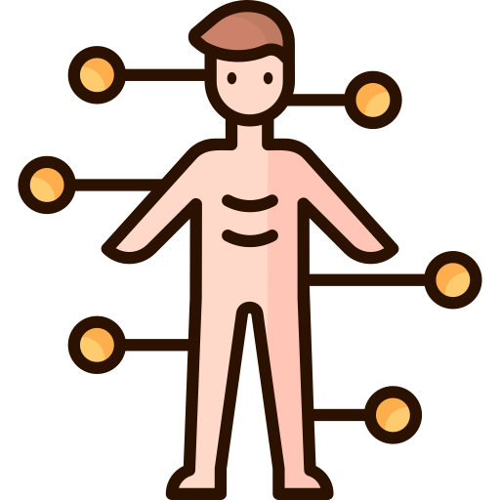
Rhannau’r Corff/ Parts of the body
pen head
llygaid (llu-guide) eyes
clust(iau) (cl-isst(ee-I) ear(s)
trwyn (tr-oo-een) nose
ceg (k-airg) mouth
braich/breichiau (br-I-kh/br-aykh-ee-I) arm(s)
coes(au) (koyss) leg(s)
troed/traed (troyd/tried) foot/feet
llaw/dwylo (llow/do-ee-lo) hand(s)
gwallt (goo-allt) hair
bola (bor-lar) stomach

Slide 13

Dillad/Clothes
ffrog (frog) dress
siwmper (sh-oomp-err) jumper
trowsus (t-row-sis) trousers
siorts (sh-or-ts) shorts
crys (crease) shirt
cot (cot) coat
sgert (sgert) skirt
crys-t (crease-tee) t-shirt
esgidiau (es-kid-ee-eye) shoes
sanau (san-eye) socks
gwisg ysgol (gwhisk usgol) school uniform
gwisgwch…! (gwhisk-ookh…!) wear…!

